Slide 1
Animation
Storyboarding an Animated Short
Image 1. Used with permission.

Slide 2
What is a Storyboard?
Storyboarding is the process of producing sketches of the shots of your script. The end result looks like comic book of your film (without the speech bubbles).
Storyboards are part of the preproduction (or planning) process that can include creating a logline, character development, scripting, and sound design.

Slide 3
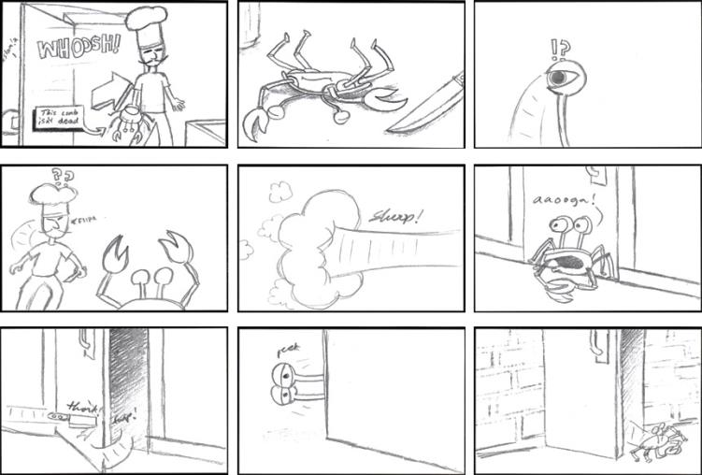
Storyboard Example
Image 2. Used with permission.

Slide 4
History of Storyboards
Walt Disney is credited with creating the modern storyboard. In 1933, “The Three Little Pigs” was completely storyboarded.

Slide 5
Group Projects
Most productions are group projects and the storyboards are essential to communicate the goal to all group members.
An animator working on an individual project may still want to create a storyboard to plan the project, choose the camera angles, and set the timing.

Slide 6
Benefits of Storyboarding
Reduces the time spent on unfocused, undirected discussion
Allows everyone to share ideas equally and promotes consensus
Helpful in generating alternatives
Cost effective, accurate planning
Perceive possible continuity problems before they happen
Communication between departments
Artistic and aesthetic vision remains consistent
Communication with client funding the project

Slide 7
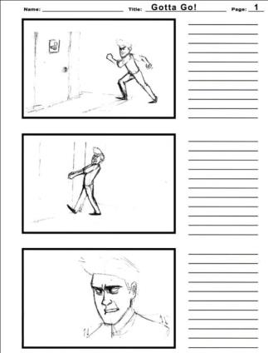
Storyboard Paper
Storyboards used for beginning story development are often rough drawings on 4” x 6” index cards tacked to a bulletin board. Panels can be easily added and the order can be shuffled.
Once the story is established, storyboard paper with 9 to 12 panels maybe be used to thumbnail (tiny rough drawings) the board.
Final production storyboards are usually done using one, two, or three panels per page.
A wide panel frame may be needed for pans and trucks (explained later).
Production storyboards should include action and dialogue.
Image 5. Used with permission.

Slide 8
Camera Placements
Strive to use a series of shots from different camera angles that rarely last longer than a few seconds.
Try to find interesting camera angles rather than straight-on.

Slide 9
Visual Focus
In most situations, do not position the subject centrally in the picture.
Use the rule of thirds by visually dividing the width and height of the frame into three parts. Try to put the most important object at one of the intersections (top left, top right, bottom left, bottom right).

Slide 10
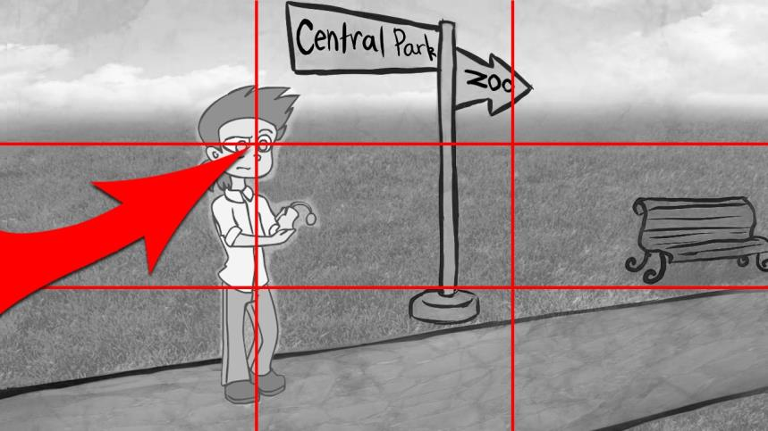
Rule of Thirds
Image 6. Used with permission.

Slide 11
Horizon Placement
In geographic terms, the horizon is where the sky meets the ground. In art, the horizon is the eye level.
Do not let the horizon (either artistic or geographic) split the frame in half.
In most cases, lower the horizon.

Slide 12
Horizon Examples
Image 7. Used with permission.

Slide 13
Lens Examples
Image 8. Used with permission.

Slide 14
Camera Shots: Wide and Establishing Shots
Wide shot – A shot which is taken from a long way away showing the surroundings and the actor(s).
Establishing Shot – A wide shot that lets the audience know where the action is taking place.

Slide 15
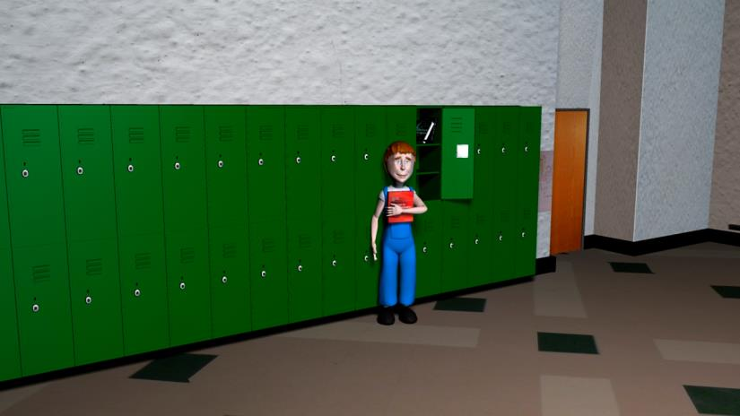
Wide Shot
Image 9. Used with permission.

Slide 16
Camera Shots: Long Shot
Long shot – This is closer than a wide shot. You can see the person from head to toe, but you can still see what's around them. Many times the action is best displayed using this full-body shot.

Slide 17
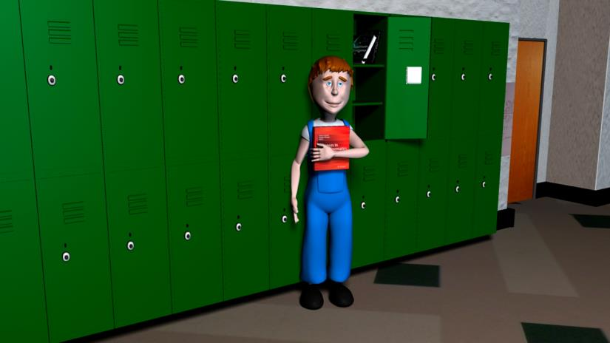
Long Shot
Image 10. Used with permission.

Slide 18
Camera Shots: Medium Shot
Medium shot – This shows someone from just below their waist to just above their head. When you use a medium shot, the viewer is close enough to see actor's expressions but can see what the actors are doing with their hands as well.

Slide 19
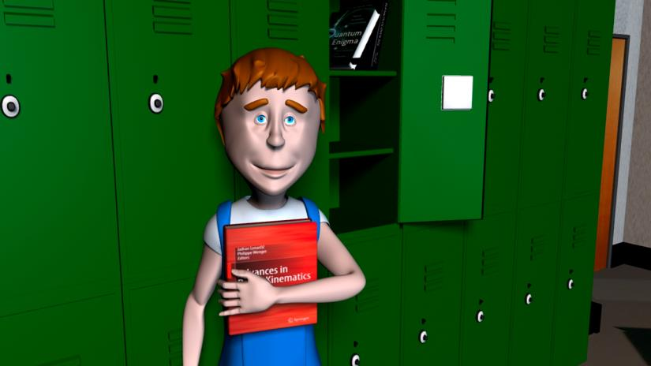
Medium Shot
Image 11. Used with permission.

Slide 20
Camera Shots: Close-up
Close-up – This shows just the head of the person being filmed. You can use this sort of shot when it's important to see someone's expression: for example, if they are scared or angry.
Extreme Close-up – A dramatic shot that shows the actors eyes and mouth.

Slide 21
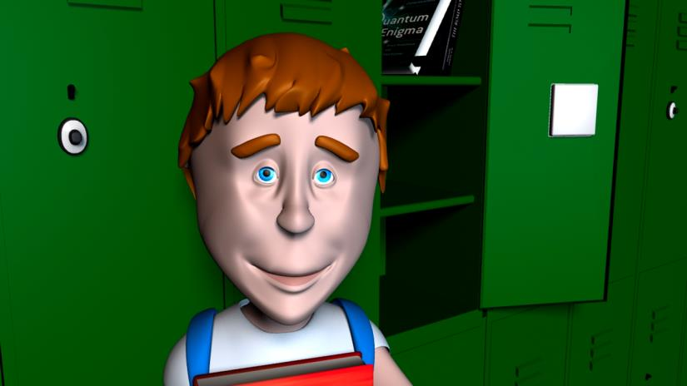
Close-Up
Image 12. Used with permission.

Slide 22
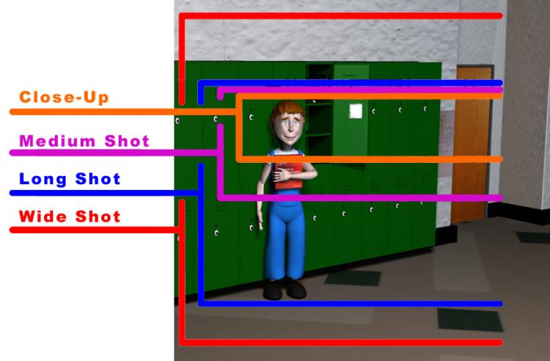
Shot Comparison
Image 13. Used with permission.

Slide 23
Camera Shots: 1, 2, 3, OTS
One Shot – Only one actor is in the frame.
Two Shot – Two actors are in the frame.
OTS – Over the Shoulder Shot. A two shot which puts focus on the character facing the camera. This shot sets up for the One Shot, as if the viewer has assumed the other character’s point of view (POV).
Three Shot – Three actors.

Slide 24
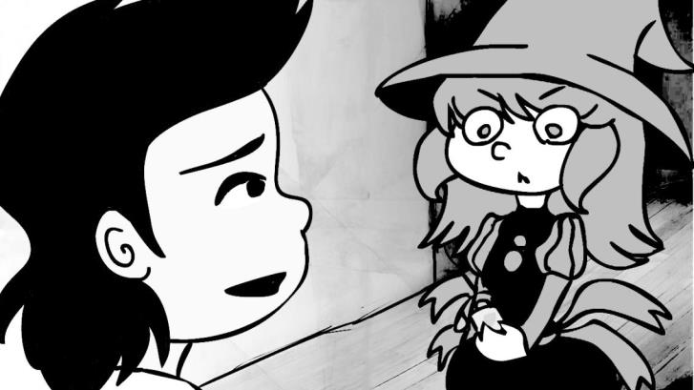
OTS – Over the Shoulder
Image 14. Used with permission.

Slide 25
Camera Shots: Inserts
An insert shot is a full screen close-up of actions, objects, text, or a character’s reaction placed as if inserted over a longer scene or over dialog.

Slide 26
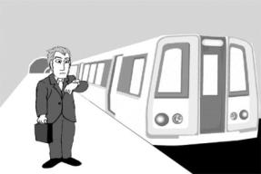
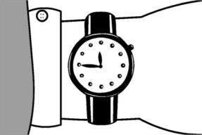
Insert Example
Image 15. Used with permission.

Slide 27
Camera Shots: Dutch Angle
A Dutch Angle tilts the camera on its bank axis which slants the horizon. It is used to create tension in a scene. Fast shots at a Dutch Angle might be used during a chase scene, a fight scene, or when a character becomes violent or confused.

Slide 28
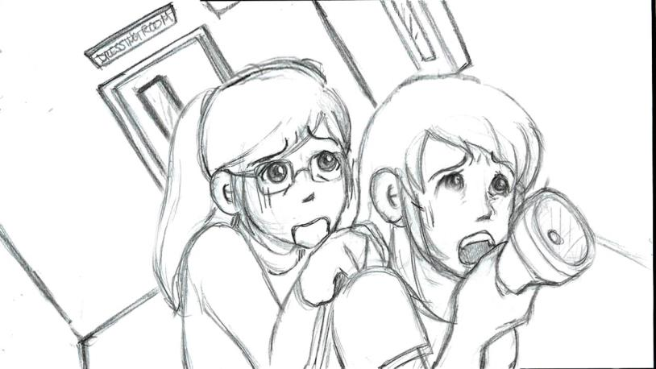
Dutch Angle Example
Image 16. Used with permission.

Slide 29
Camera Movement: Dolly
Dolly is moving the camera into the shot, getting closer to the action. This is similar to zooming in on the action.
Use thick white arrows to show camera moves and thin black arrows to show objects or actors moving.

Slide 30
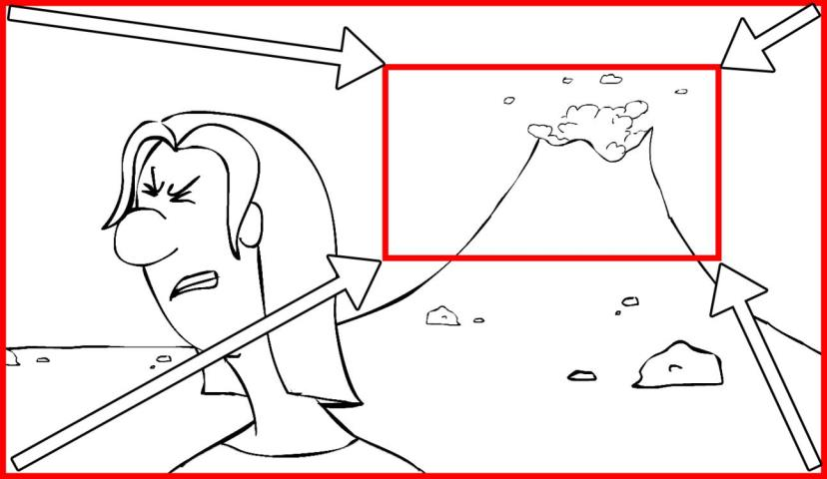
Dolly Storyboard
Image 17. Used with permission.

Slide 31
Camera Movement: Pan
Panning is rotating the camera on a tripod to slowly reveal a wide section.
To show this on the storyboard, create a wide drawing and use a floating frame. Connect the frames with arrows to indicate the direction and mark “start” and “stop” on the appropriate frames.
Normal storyboard paper often makes this difficult to show. A wider panel frame is better.

Slide 32
Storyboard Pan
Image 18. Used with permission.

Slide 33
Transitions
When possible, help your audience with scene transitions by hinting at the new location in the final frame prior to the cut. Example: First scene is in a school hall and second shot in a classroom. Show the door to the classroom prior to the transition.
Special transitions may be needed for the passage of time, flash backs, dreams, etc. Simply write on the panel a description: clock wipe or fade to black.

